Slide 1
Journey Scrapbook
Akshat Gupta
Batch-6

Slide 2
Custom Training Week - 4
19-Sept-2023 to 22-Sept-2023

Slide 3
Day 1
Python Functions –
Function composition
Recursive function
Generator function
Decorator function (logging)
Types of Argument
Classes
List Comprehension
Lambda function

Slide 4
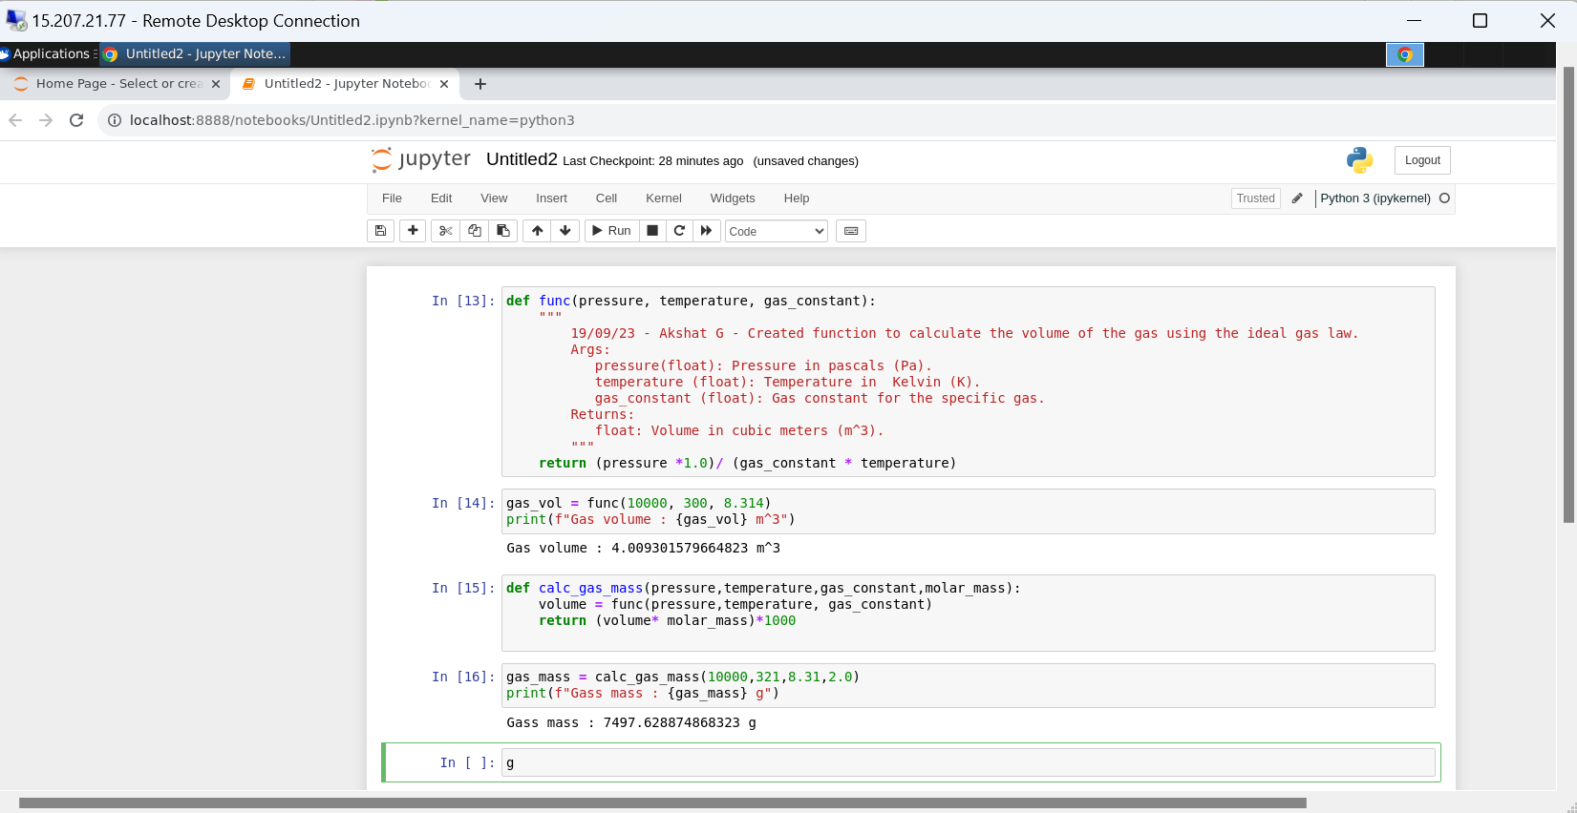

Slide 5
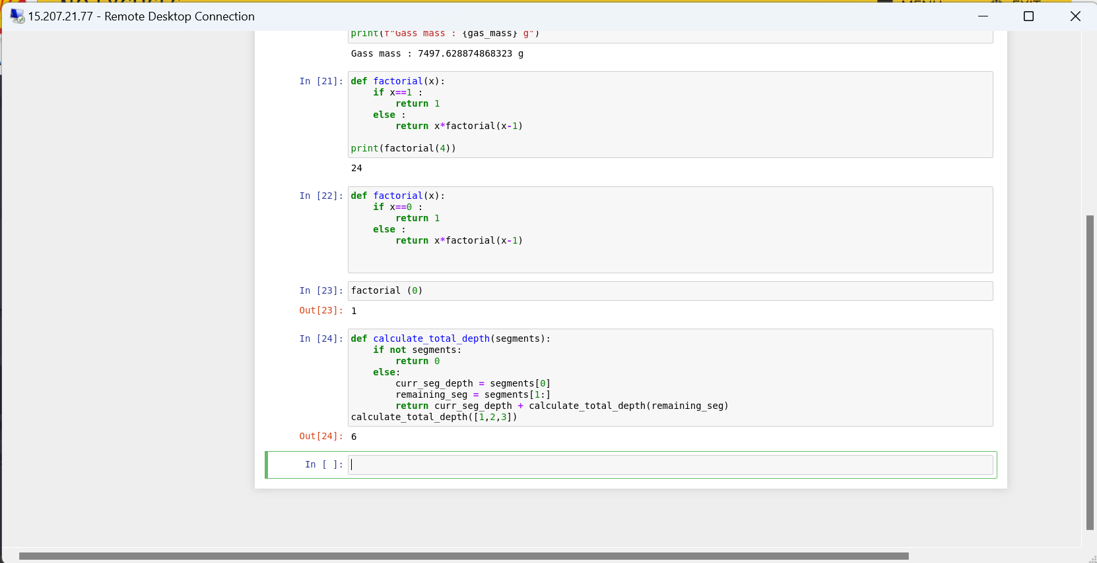

Slide 6
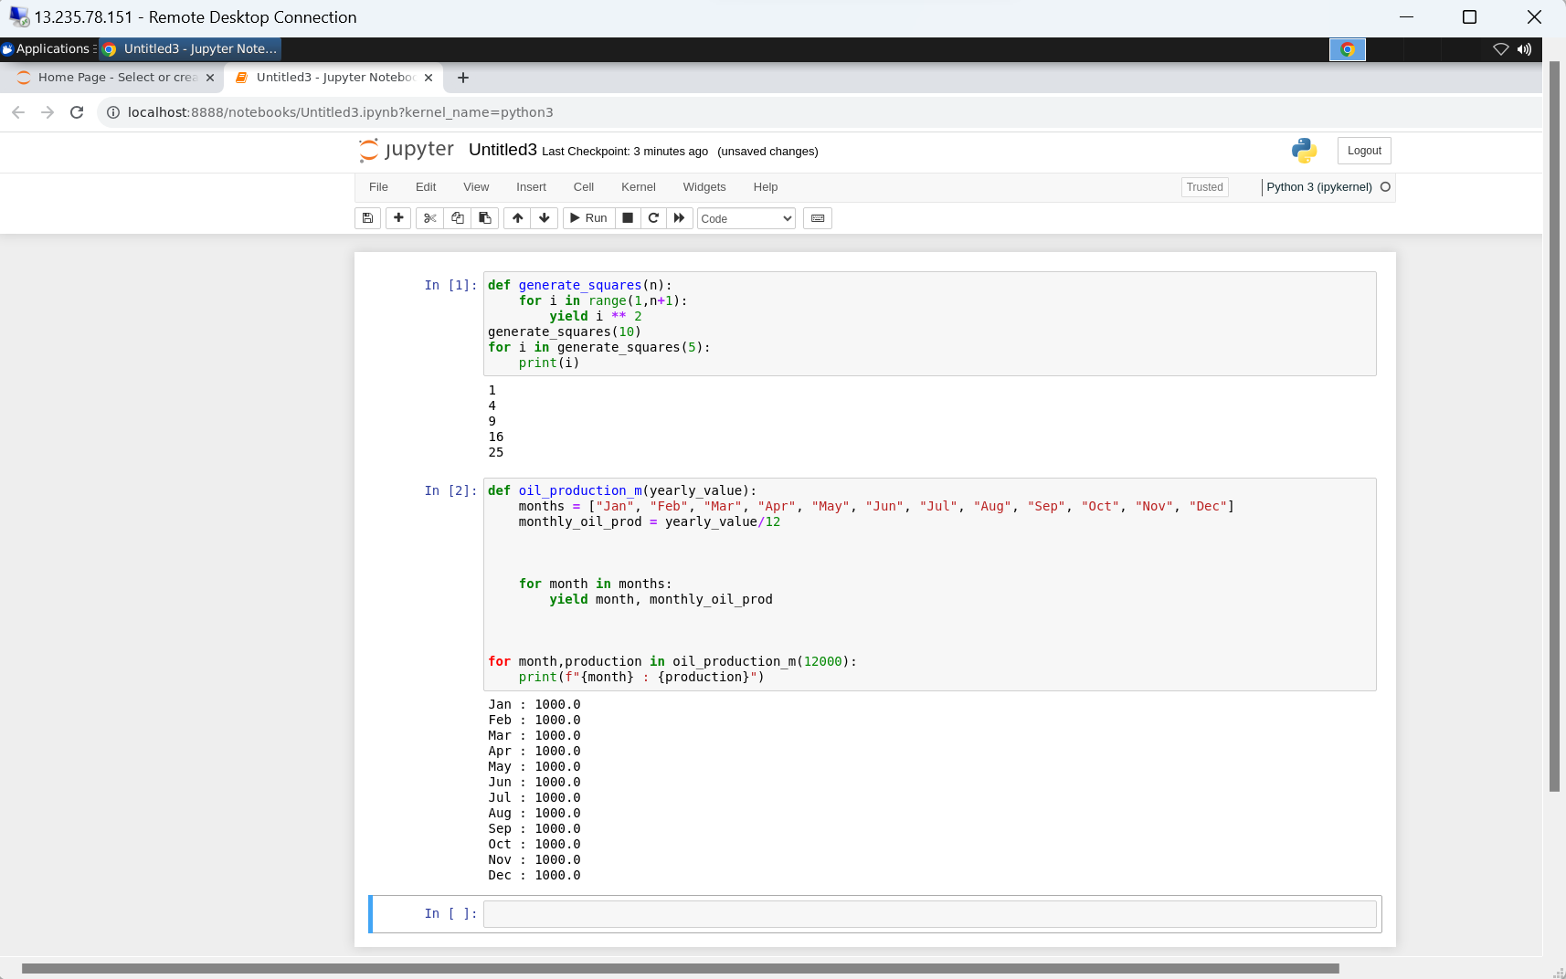

Slide 7
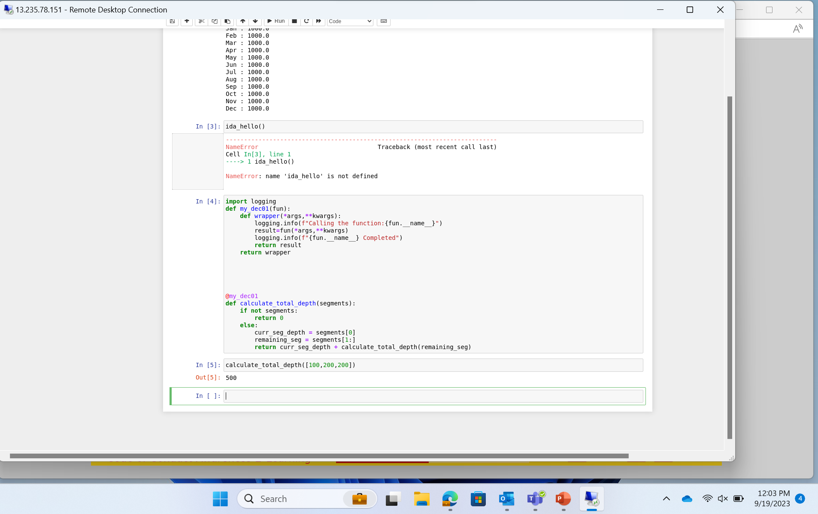

Slide 8
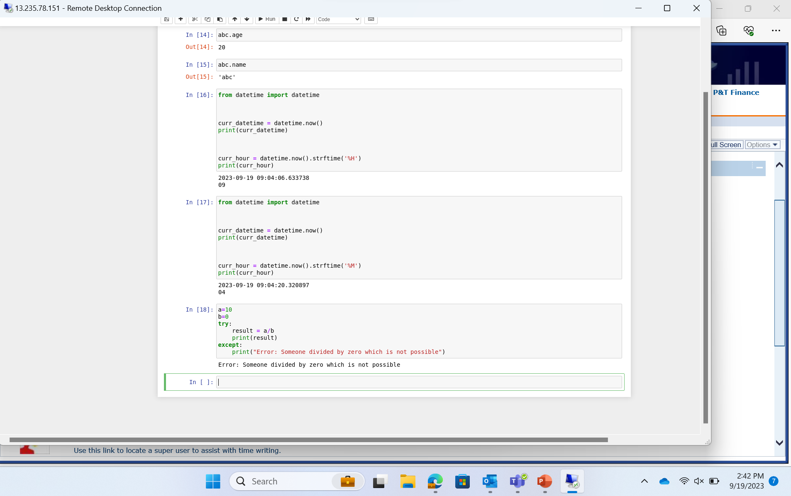

Slide 9
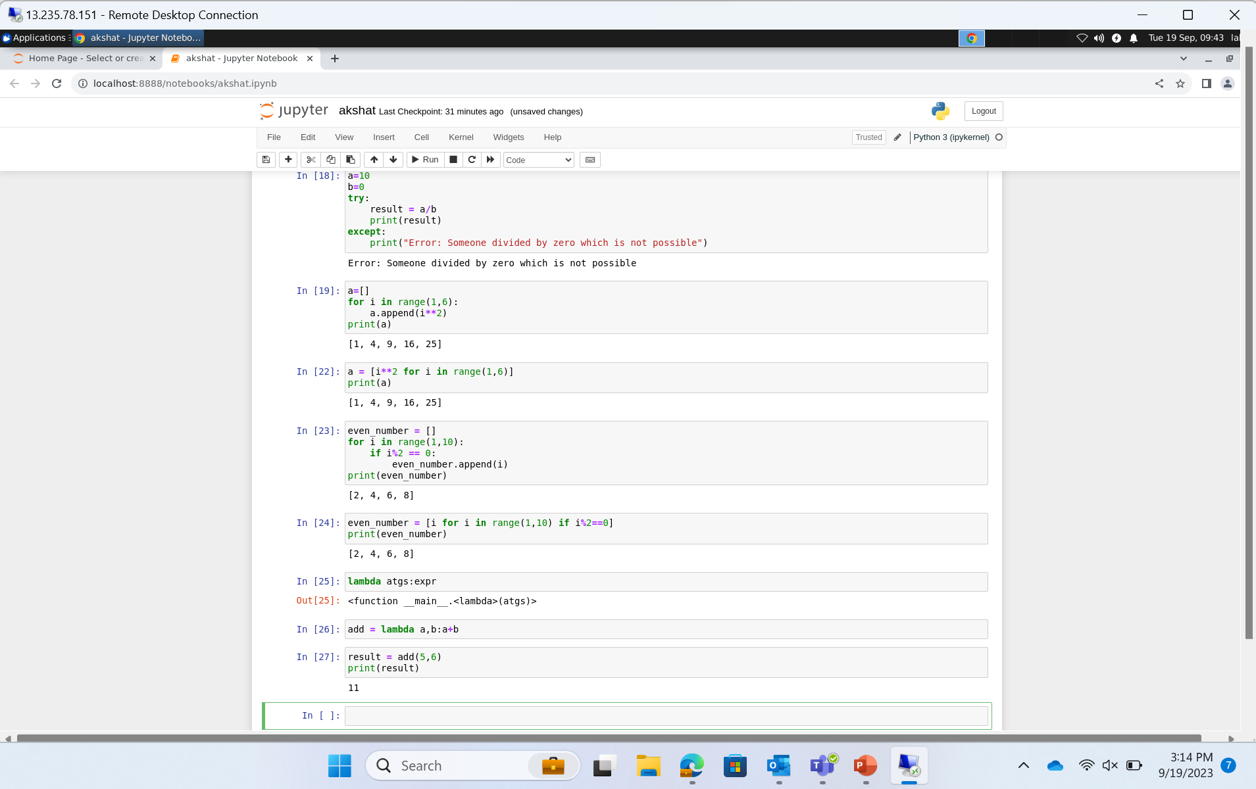

Slide 10
Day 2
PANDAS – Panel Datasets
Dataframe
Functions on dataframe
Changing column to lowercase
Dropping Null Values
Dropping columns with null values
Filling null values
Describe columns
Value counts()
Selected rows or columns of dataframe
Conditional selection

Slide 11
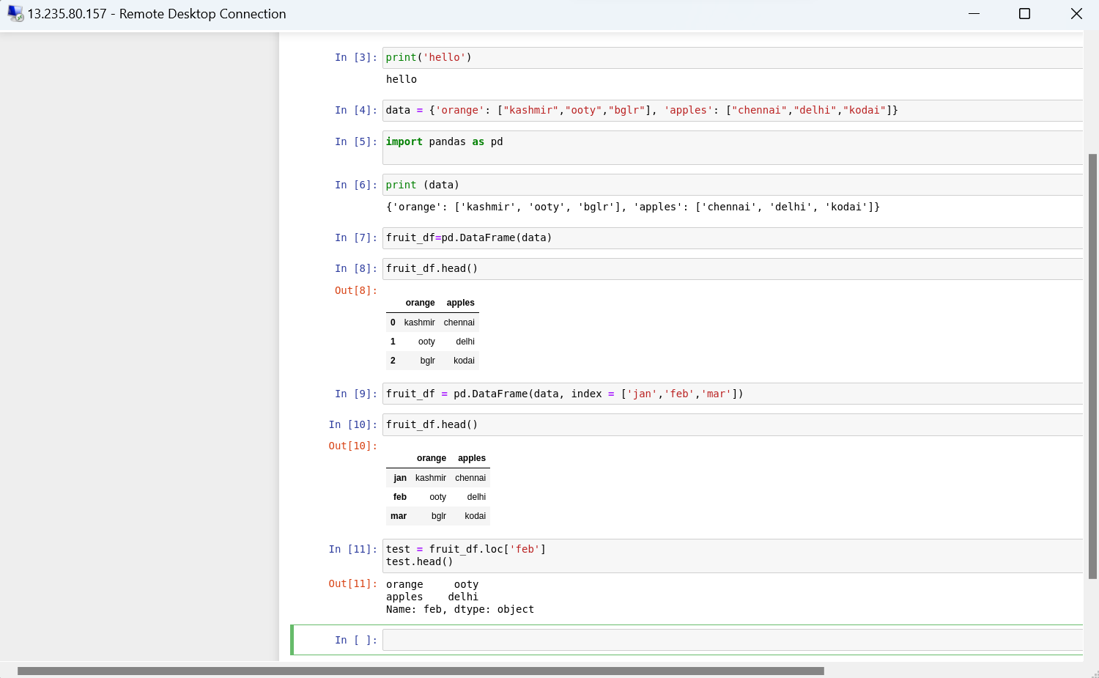

Slide 12
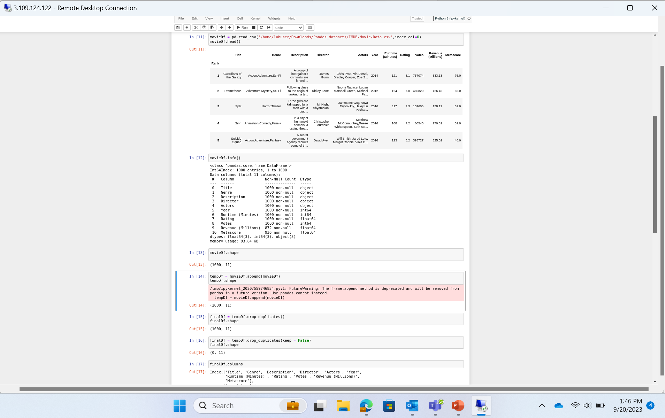

Slide 13
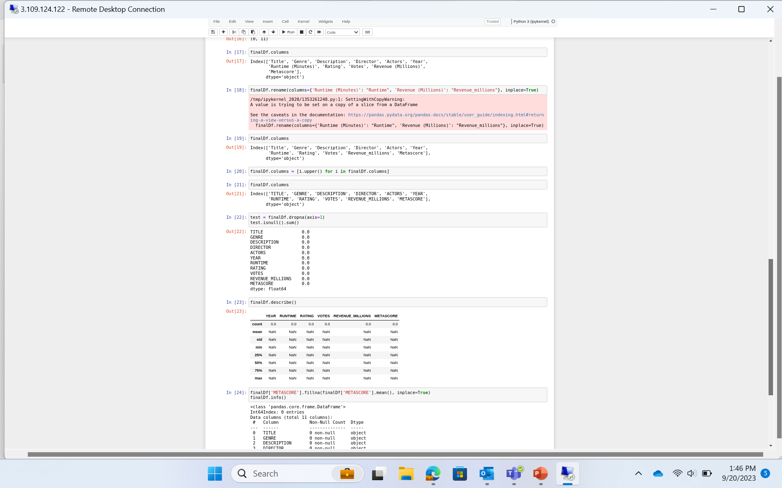

Slide 14
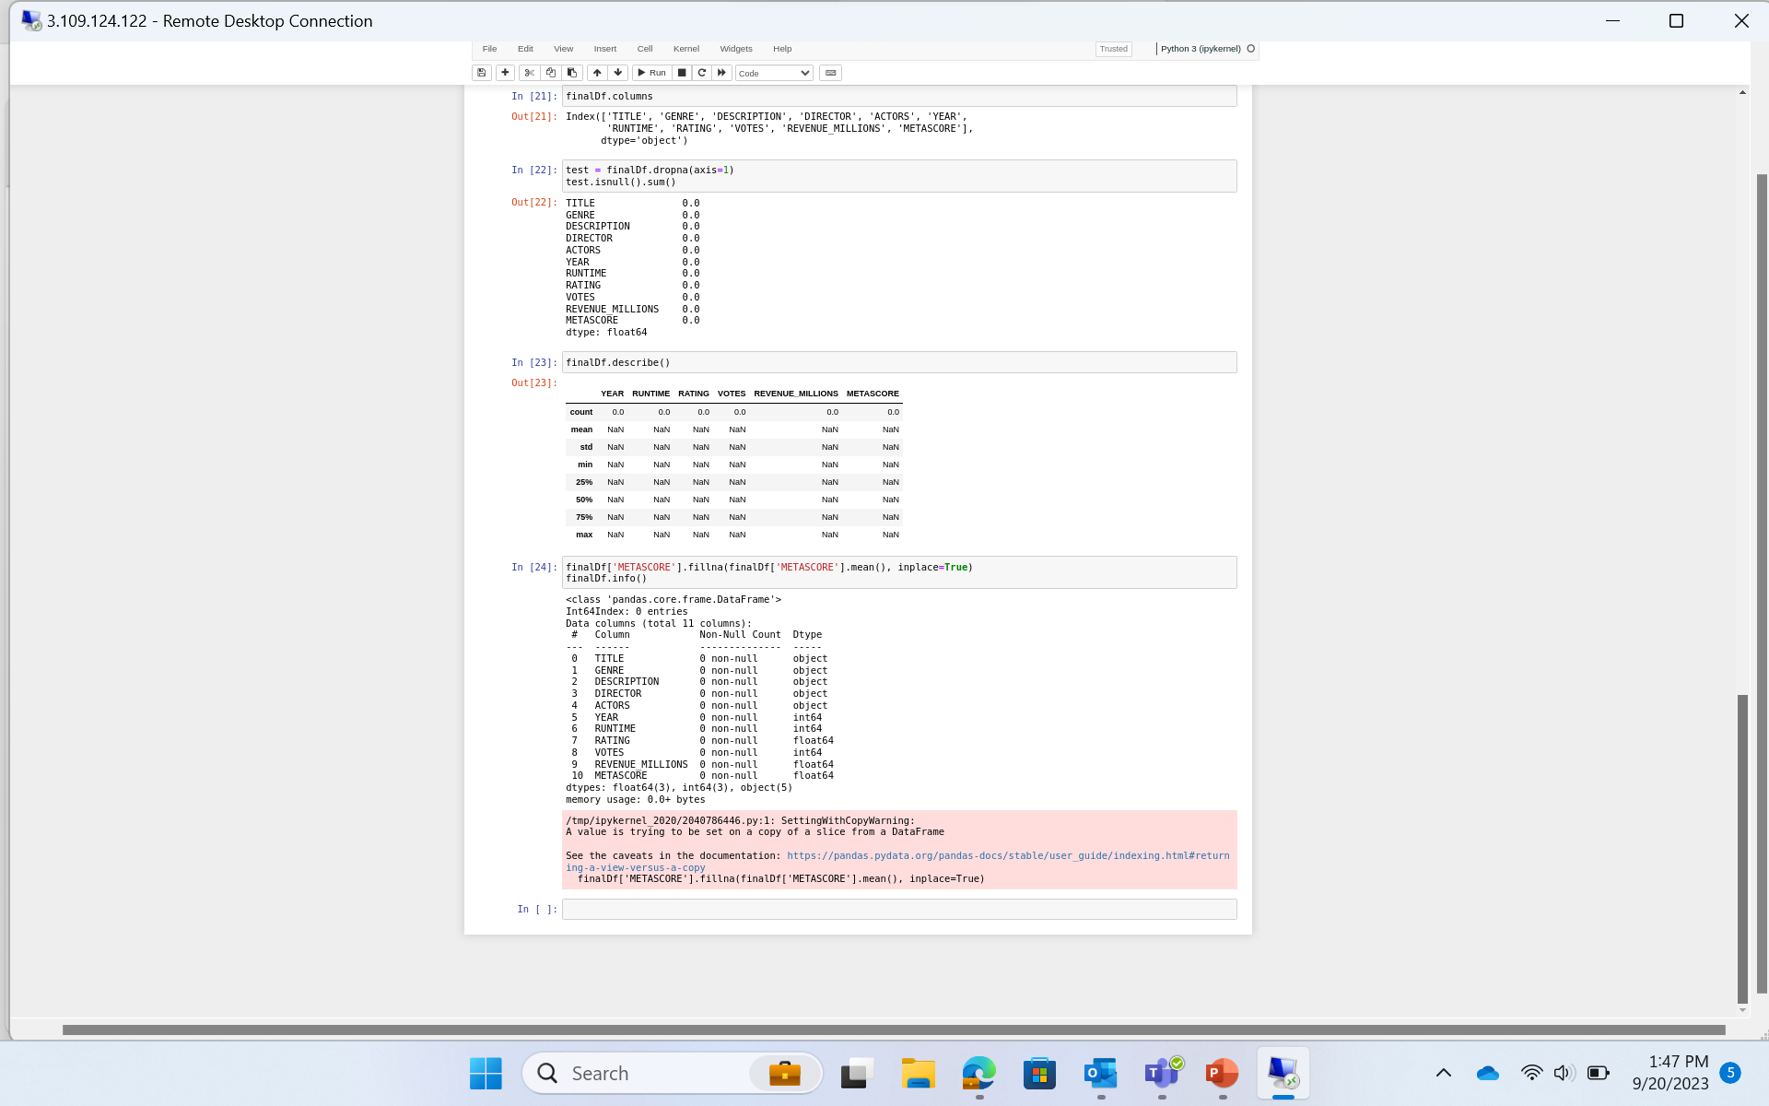

Slide 15
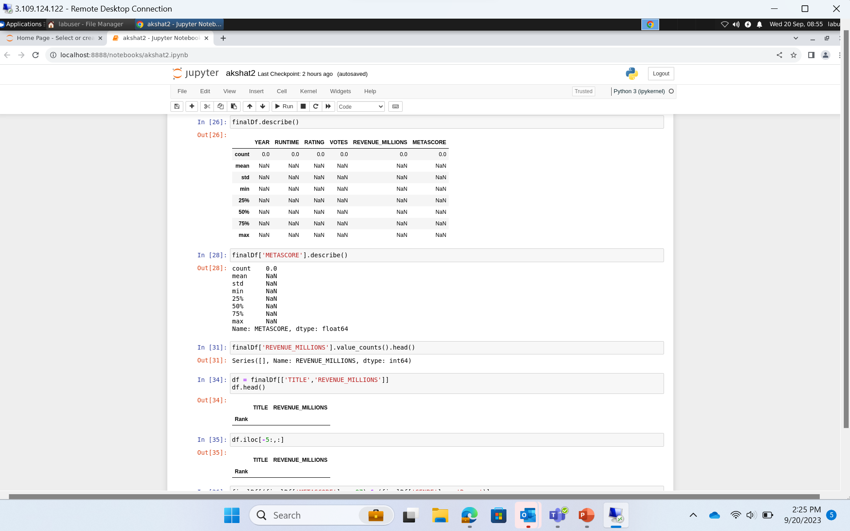

Slide 16
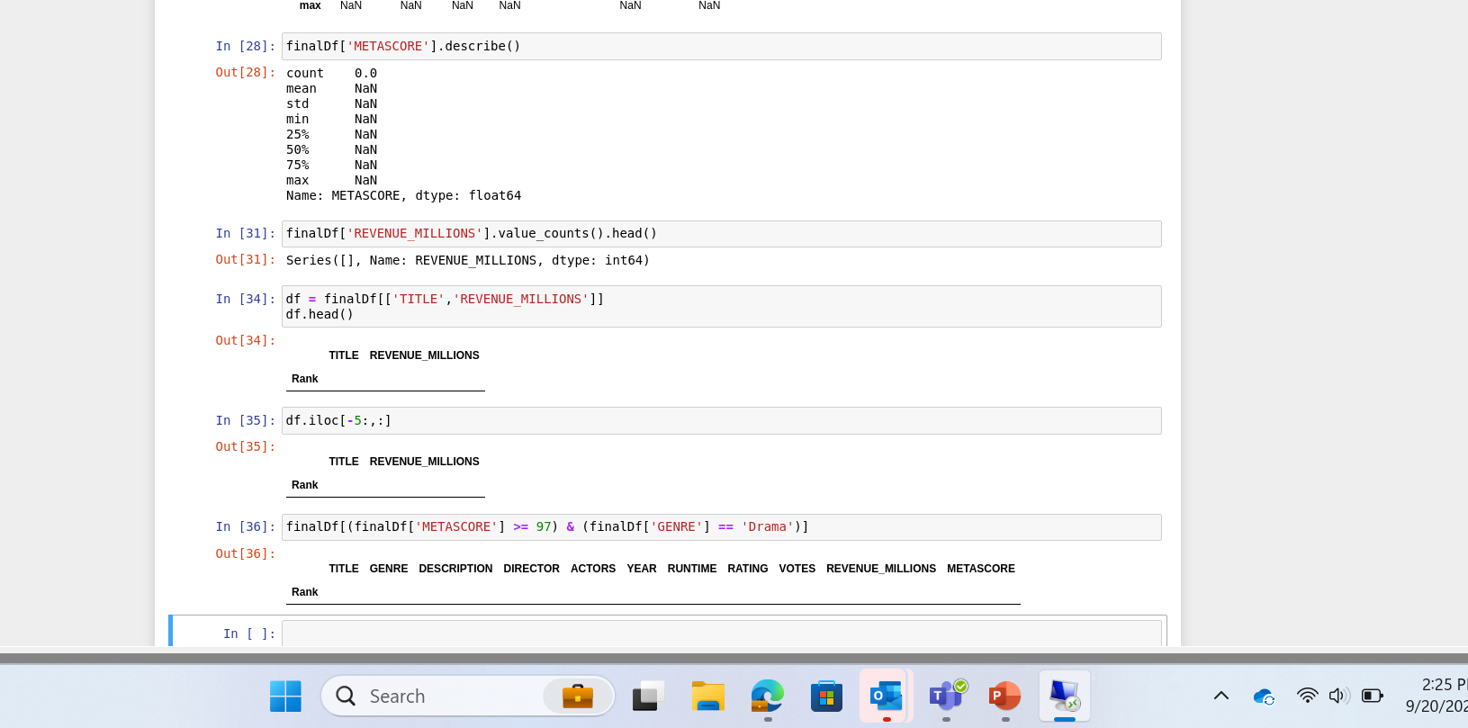

Slide 17
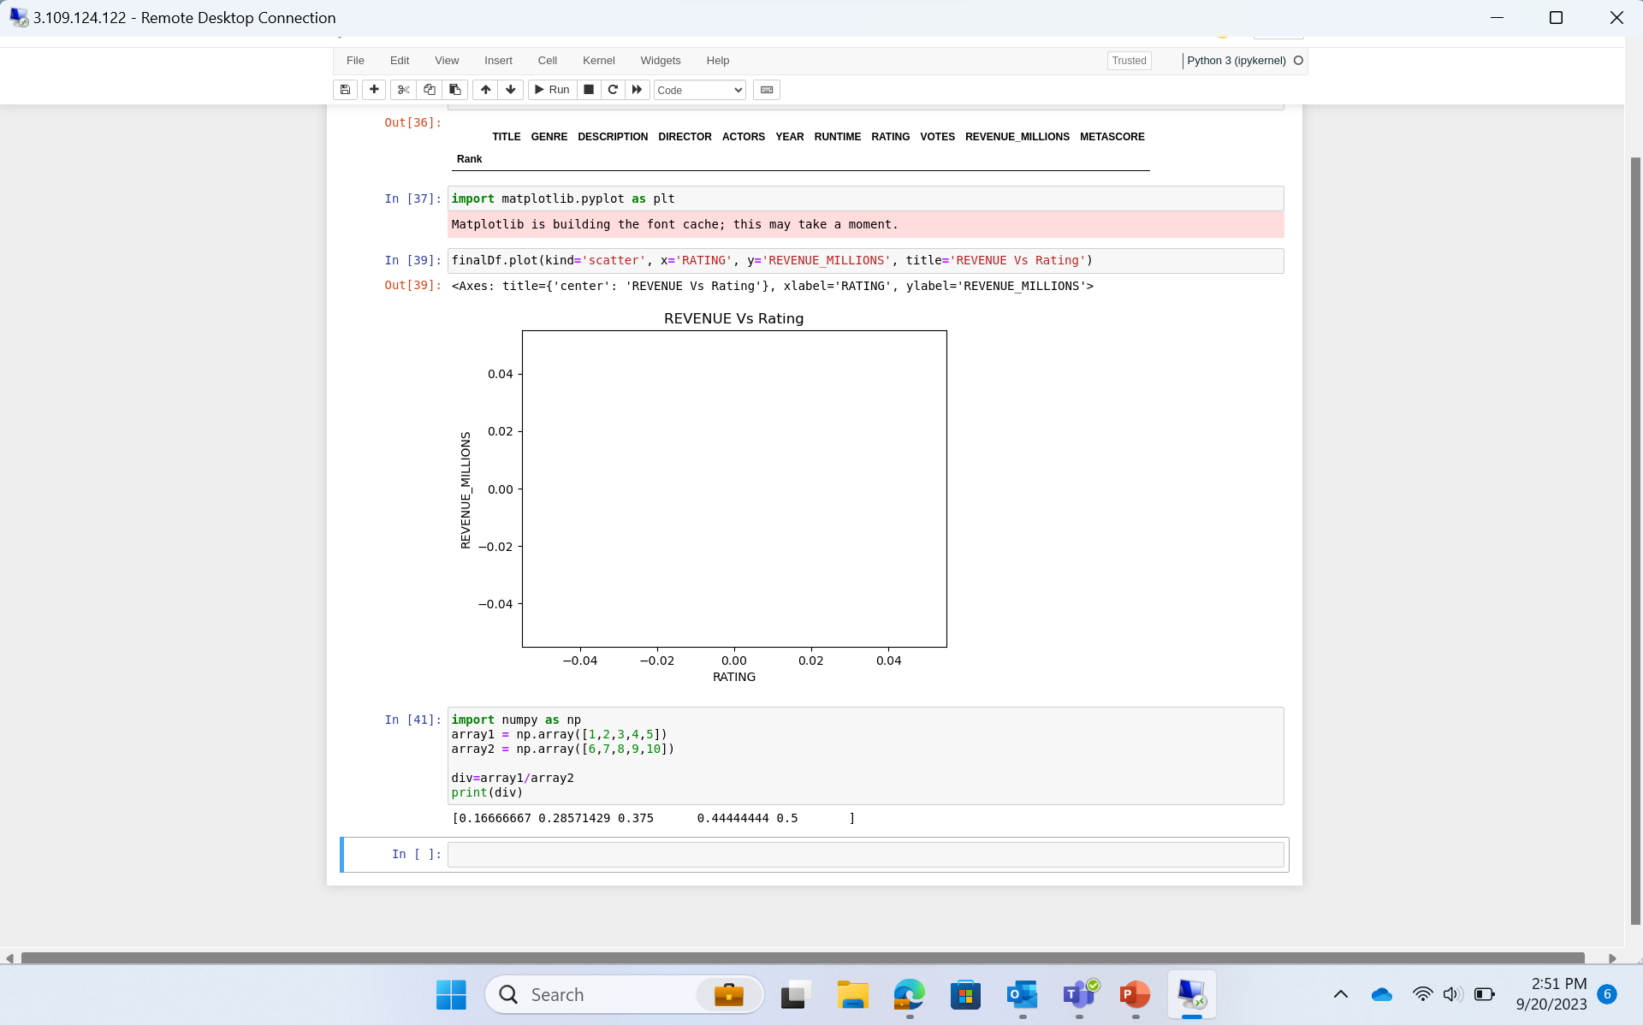

Slide 18
Day 3
PySpark
Driver process
Executors
Cluster Manager
Partition
Job, Stage and Task
Lazy Evaluation
RDD (Resilient Distributed Dataset
Caching, Catalyst, Tungsten
RDD vs Dataframe
2 transformations – WithColumn and WithColumnRenamed

Slide 19
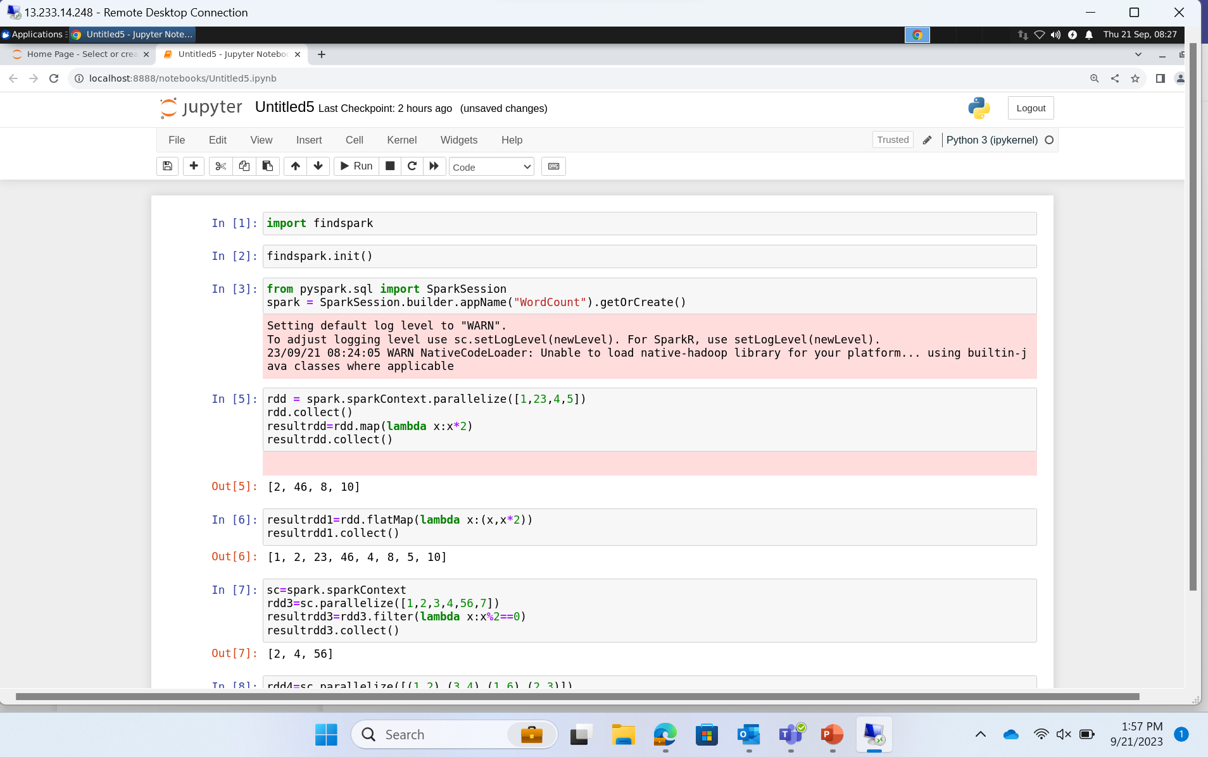

Slide 20
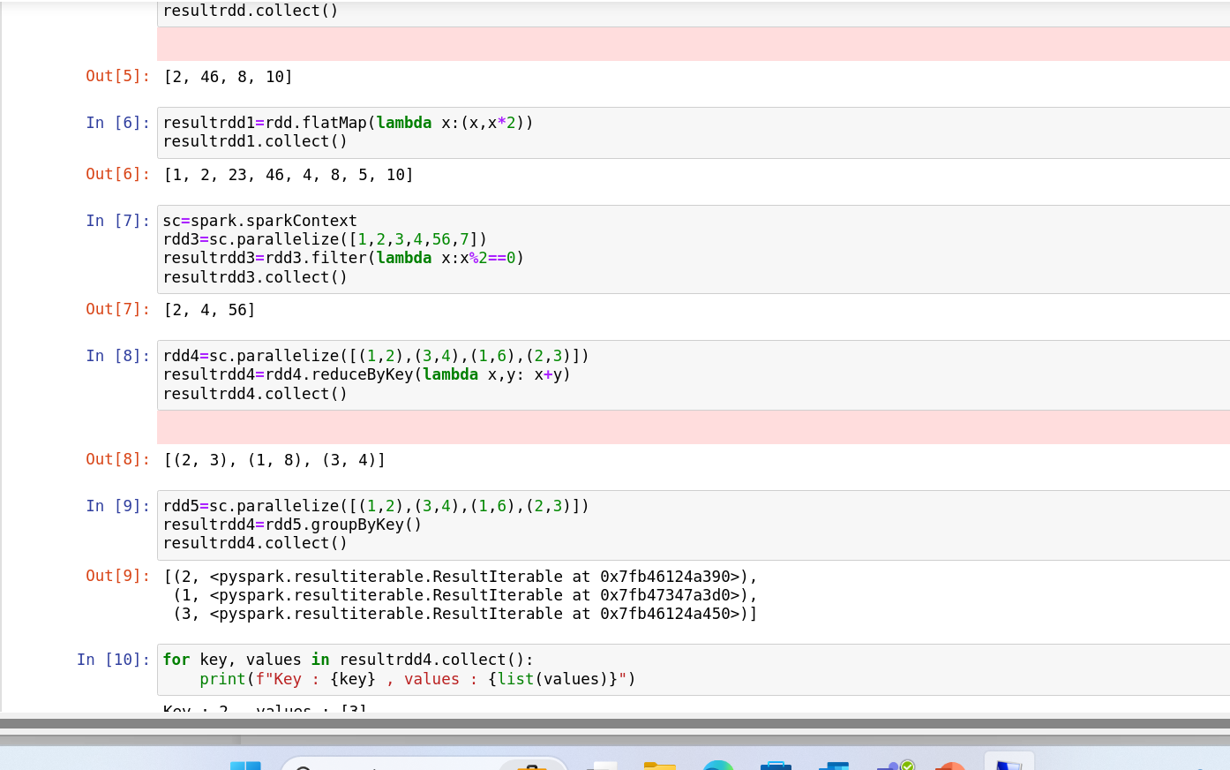

Slide 21
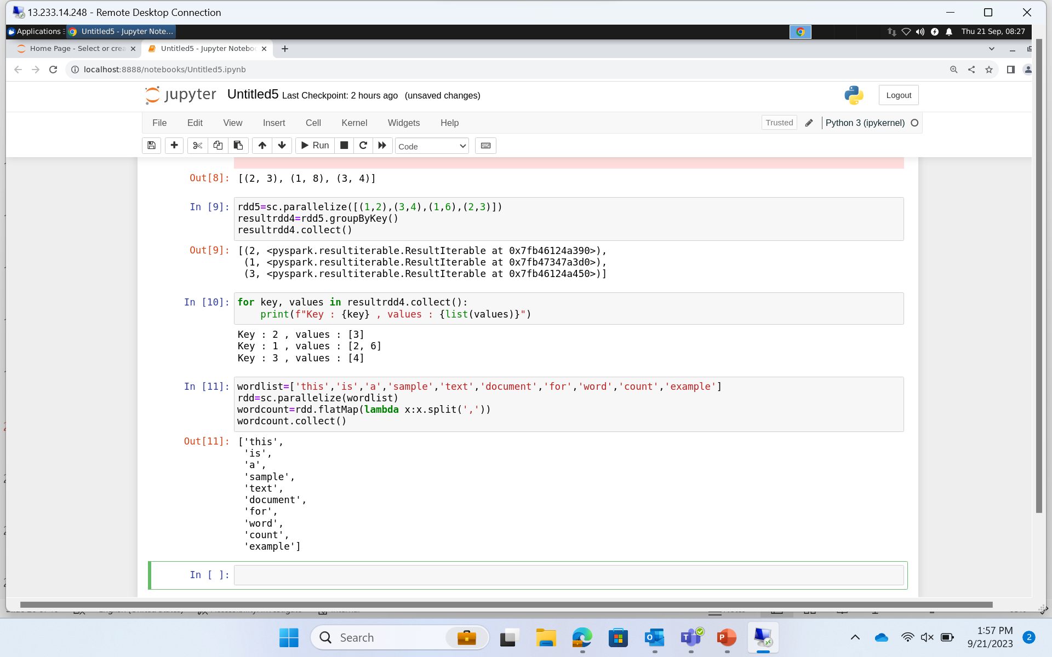

Slide 22
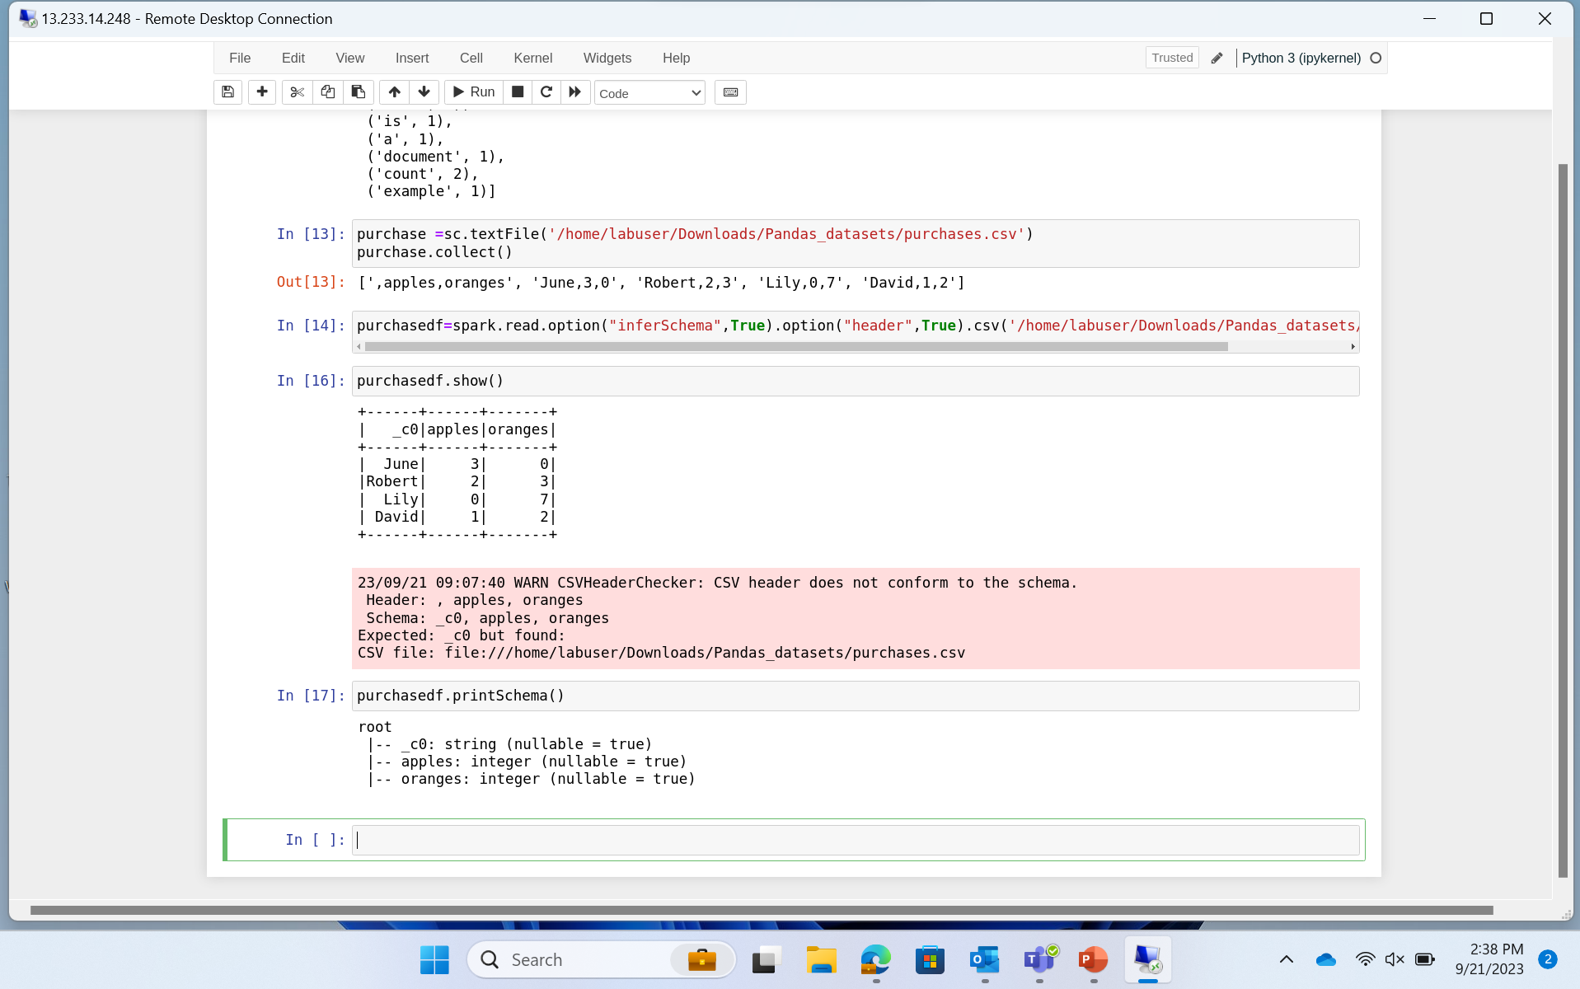

Slide 23
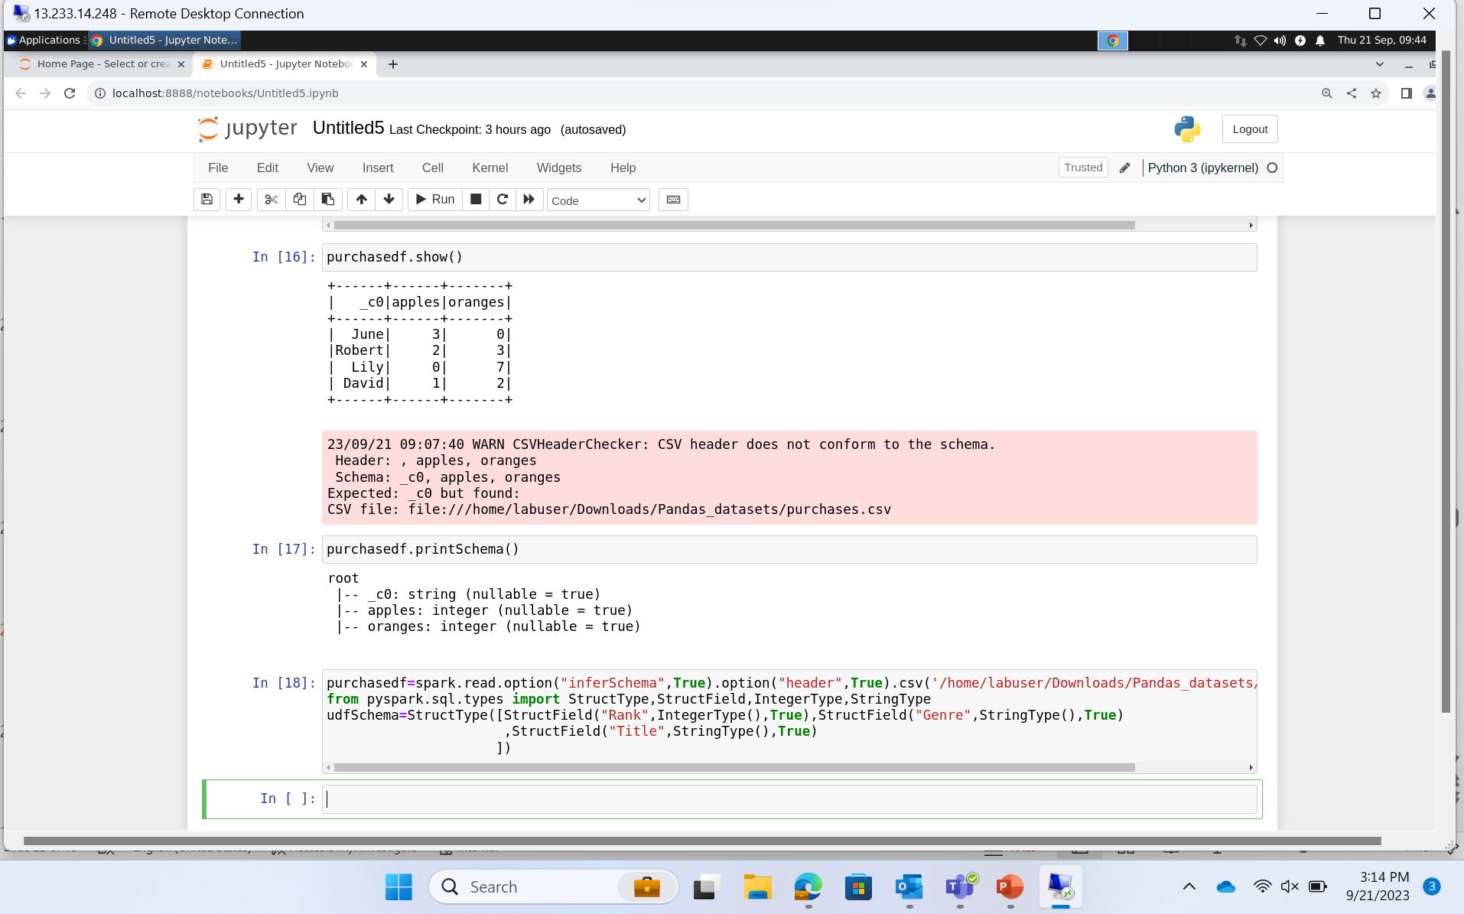

Slide 24
Day 4 – PySpark
Partitioning
Spark UI URL
SQL in PySpark
Drop duplicates
When – Otherwise condition
Concat and Functions
Caching
Joins
Group By

Slide 25
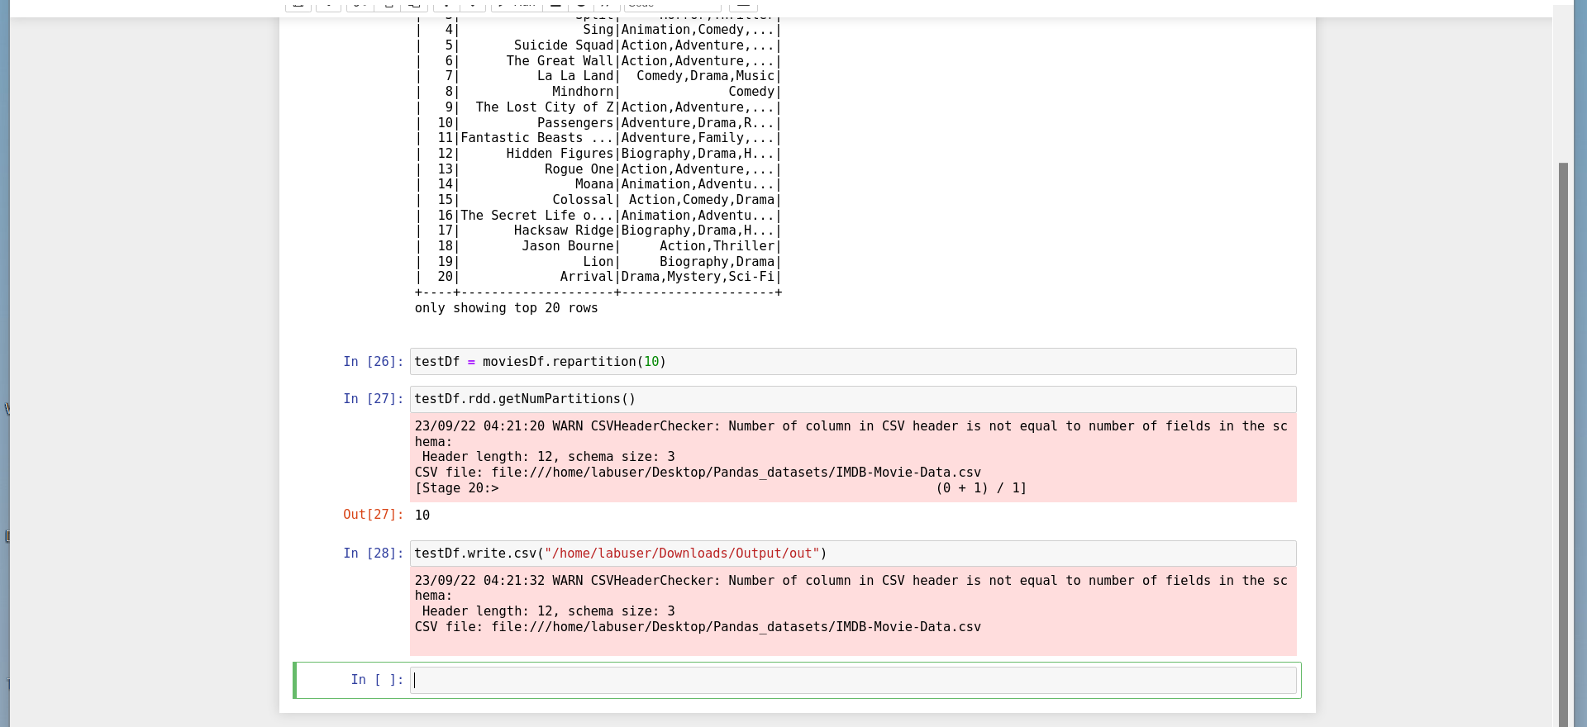

Slide 26
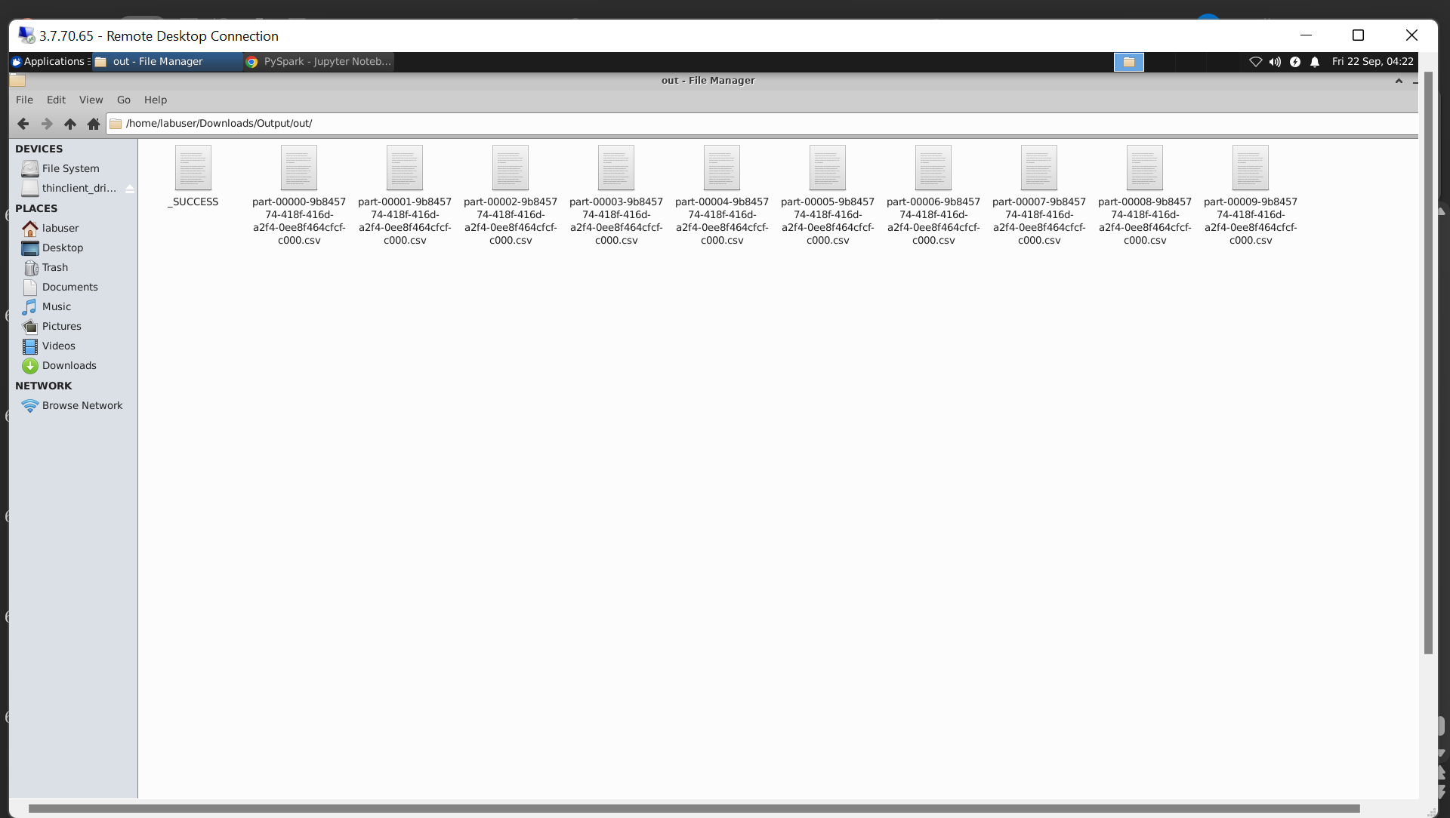

Slide 27
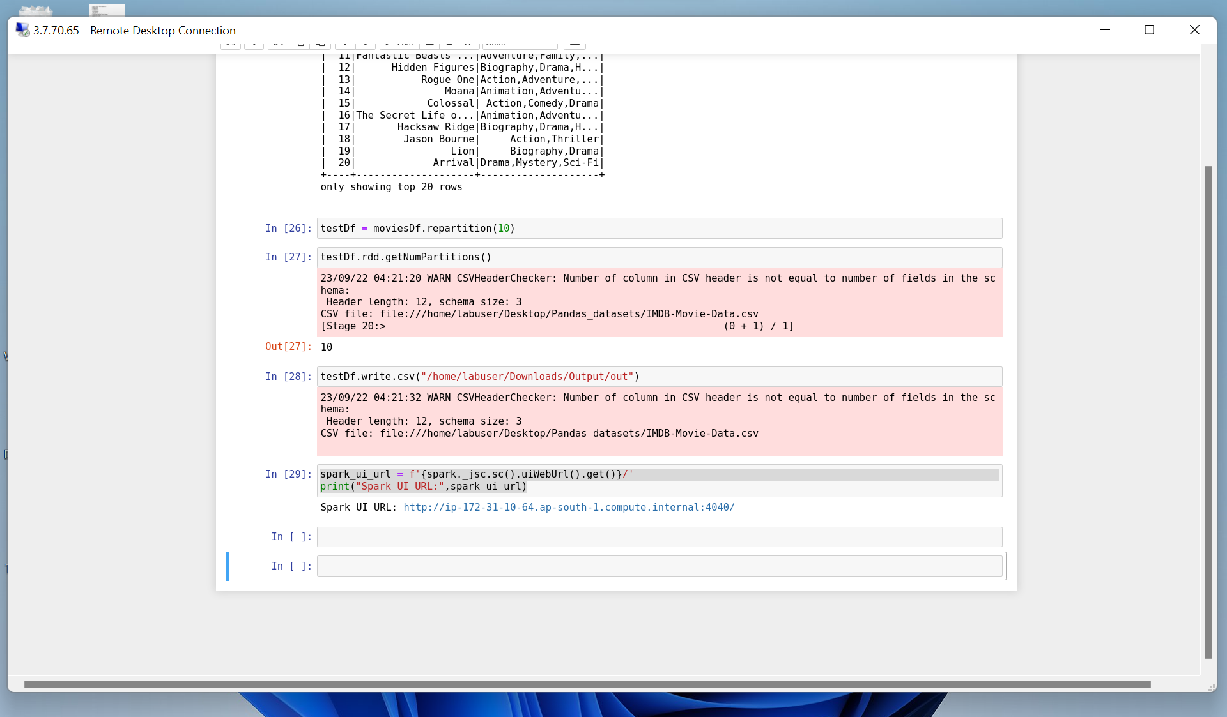

Slide 28
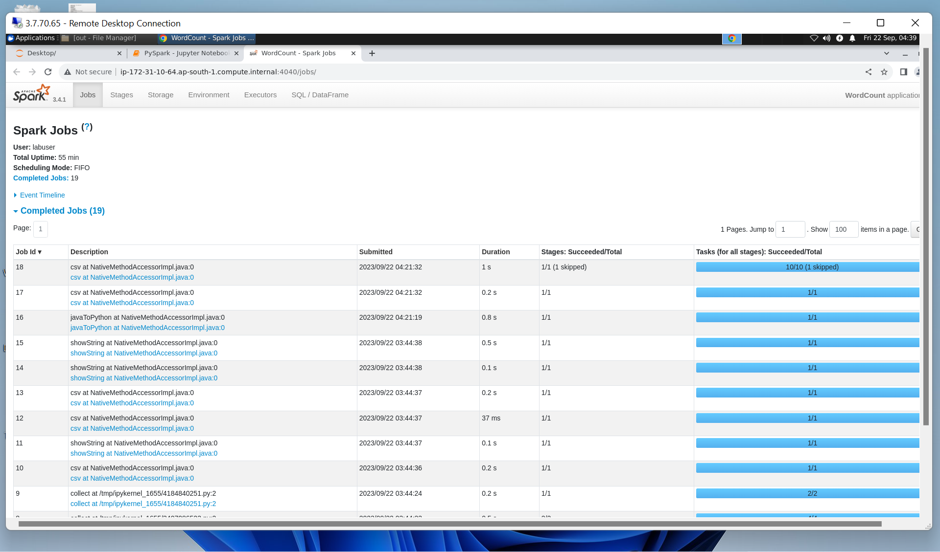

Slide 29
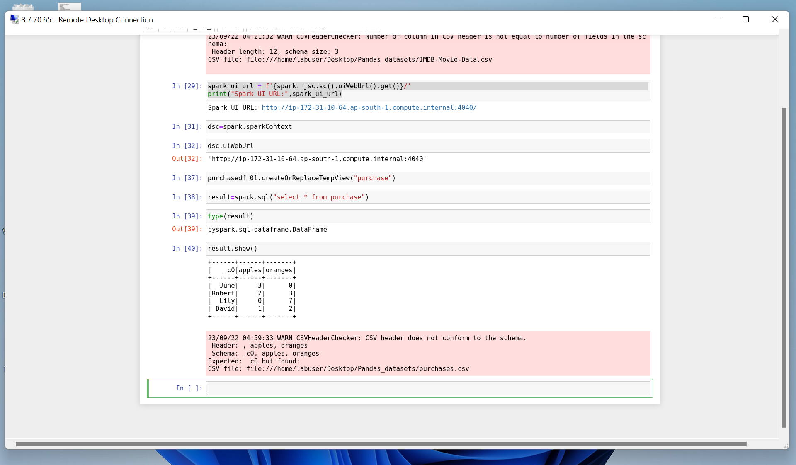

Slide 30
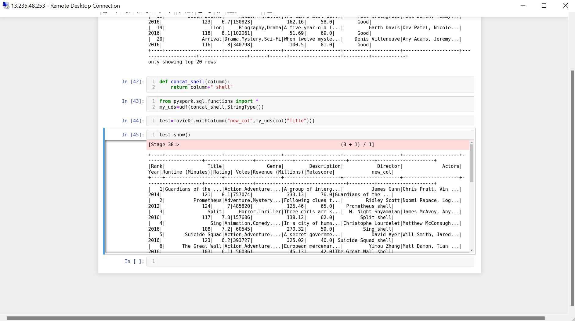

Slide 31
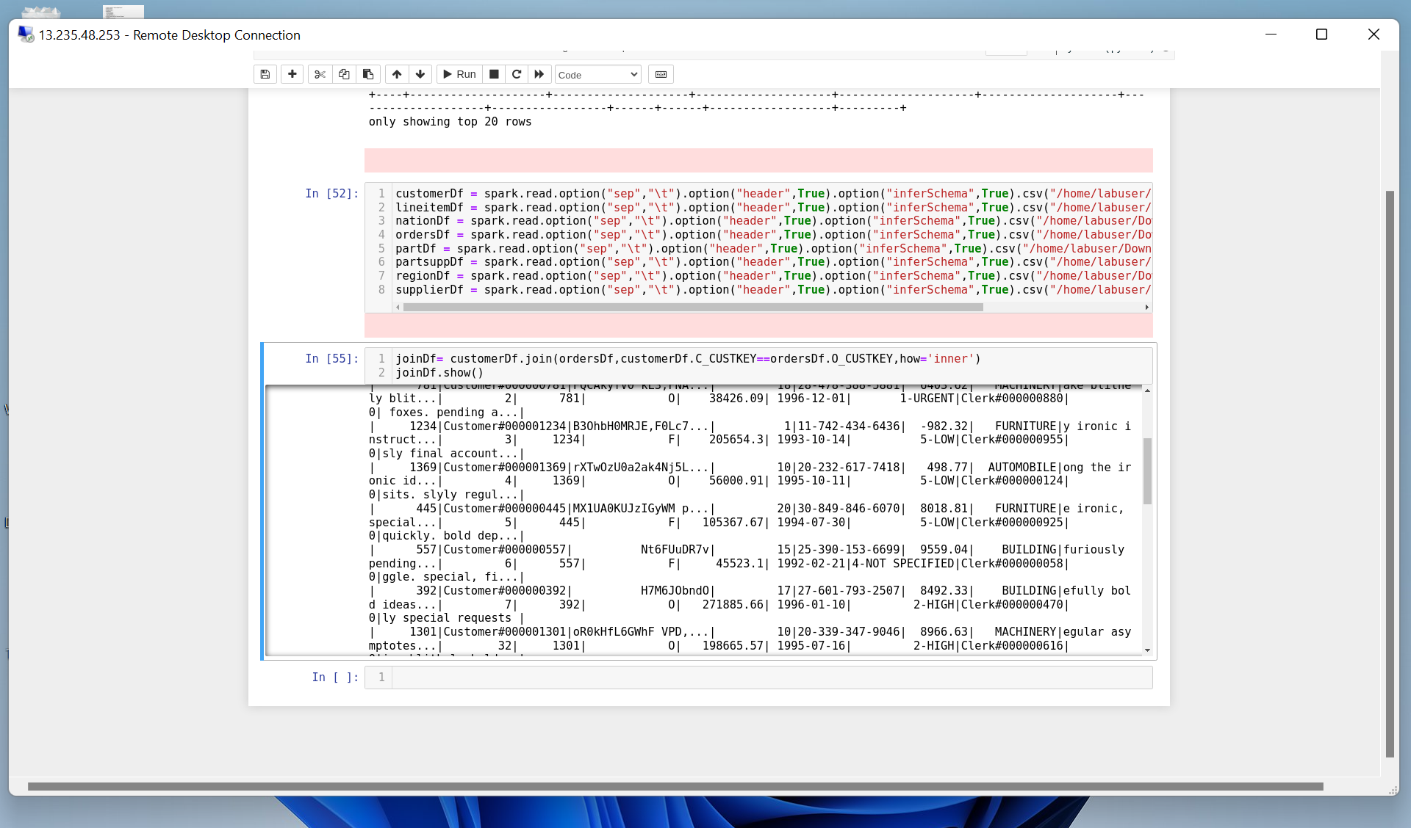

Slide 32
Thank you
Akshat Gupta
Akshat.gupta2@shell.com

